Slide 2


About Pragma IoT
Who we are
Pragma IoT is one of the leading Greek technology companies, specializing in data analytics, artificial intelligence and large language models (LLMs). It provides cutting-edge solutions to forward thinking companies in the international market.

Slide 3
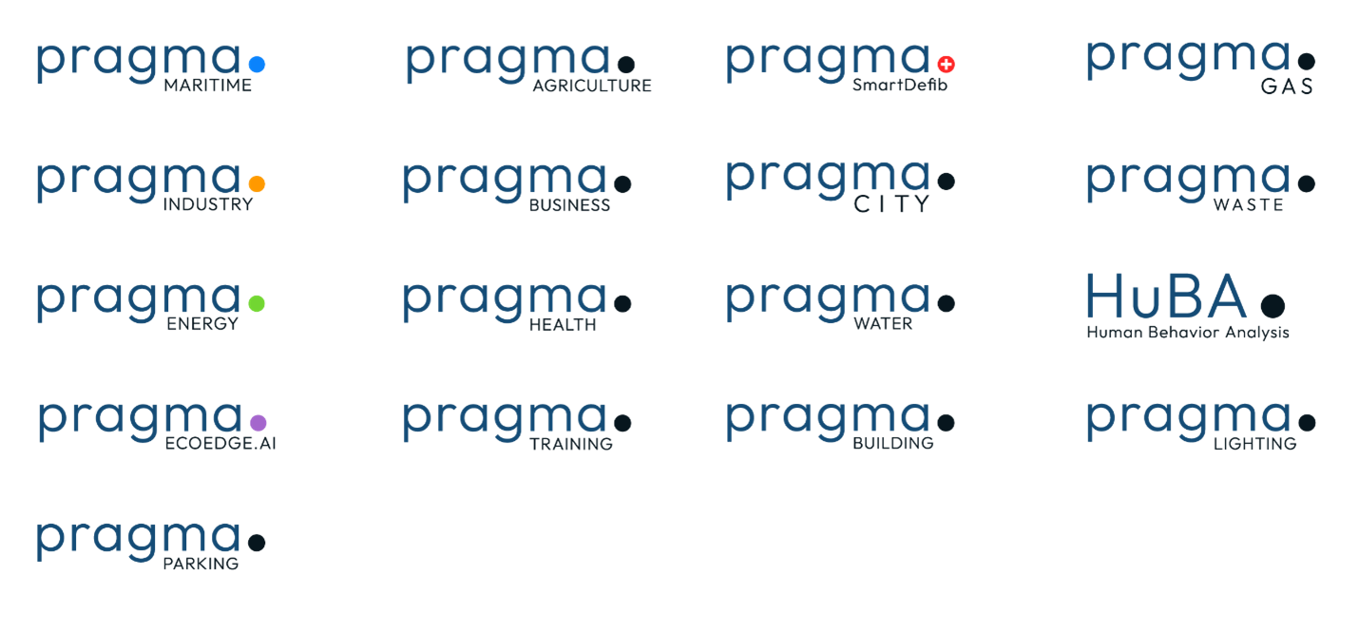
Services & Products

Slide 4

Industrial Platform
Proprietary Technologies
Proprietary Connectors & Middlewares for Industrial Protocols (e.g., OPC UA/DA/XML, Modbus, Profinet, etc.)
Proprietary Interfaces with Scada & ERP Systems (e.g., HMIs, PLCs, SAP, etc.)
Fog Computing custom gateways process some data before forwarding it to the cloud
Bidirectional Communication with Production Lines (start/stop production, change production line parameters, etc.)
Production Optimization Engine to improve the efficiency, output & quality of manufacturing or production systems.
Predictive & Preventive Maintenance Engine to maintain equipment, minimize downtime, and reduce costs.
Ensures that machinery and systems operate efficiently and safely, but they differ in how and when
maintenance is performed.
Fault Detection Engine that identifies defects/issues in equipment in both reactive & proactive manner
Industrial KPIs & Analytics (e.g., OEE, TEEP, etc.)

Slide 5

Energy Platform​
Proprietary Technologies​
Energy Disaggregation from a single central Energy Meter of a household into individual appliances energy consumption​
Hi-freq content analysis to capture appliance-specific usage patterns​
Hi-accuracy for appliance energy prediction (TECA score ~90%)​
x-home & x-device type data augmentation.​
Thermal & Visual Comfort Inference Tool for assessment & optimized prediction of the comfort levels of occupants in closed environments ​
Occupancy Inference Tool for the presence of people based on privacy-preserving AI modelling of energy consumption data & motion detectors​
Gamification Engine integrates game-like elements and principles into smart home systems to enhance user engagement, motivation, and overall experience. ​
“Pragma Energy is an innovative Energy IoT platform designed to optimize energy consumption and enhance efficiency in buildings and industrial settings, helping organizations reduce energy costs, improve comfort, and achieve sustainability goals through smarter energy management”​

Slide 6


Maritime Platform​
Proprietary Technologies​
Multi-factor Routing Optimization: Real-time weather routing that optimizes route selection, trip duration, and fuel consumption ​
Route/Maintenance-specific Analytics: Identifies patterns to detect wave-walls, assesses hull fouling status, and predicts potential engine issues​
Model-based simulation engine: Simulates environmental conditions to calculate added resistance and evaluate the environmental impact​
Emissions Optimization: Optimizes vessel trip operations to ensure compliance with environmental regulations​
“Pragma Maritime is a data-driven optimization platform aimed at fostering a greener maritime industry by equipping ship owners and operators with the insights necessary to meet their decarbonization objectives”​

Slide 7

AR Training Platform​
Proprietary Technologies​
X-Platform Augmented Reality Visualization Engine: On-Site training, maintenance and worker assistance Visualization of operations in 3D with Localization, Marker-less AR Technology, Event notification and Training logging ​
ML Object Recognition Technology: Object detection/recognition and provision of context aware information​
IIoT data Integration through the Pragma Industrial Platform: Overlay of IoT data directly on the equipment and facilities involved. Real-time training parameters set based on rules derived through IoT data.​
Annotated Video Conferencing Module: Integrated 2-way Audiovisual communication/annotation of worker point-of view in real-time with remote expert.​
Full-Stack Integrated Training Cloud Platform (SSaS): On-Line Visual Training Scenario Editor Formalizing SOP in digital form with multimedia and 3D content, Scenarios & Assets CMS, User Management Dashboard & Trainee Analytics​
“Pragma AR Training is a comprehensive training platform focused on Industry 4.0 and beyond offering complete command of training procedure: creation, editing, deploying and monitoring that aims to enhance workforce education by providing immersive, interactive, and hands-on learning experiences”​

Slide 8

BIM Solutions​
Proprietary Technologies​
Cross Platform Virtual & Augmented Reality BIM visualization Engine: Augmented and Virtual Reality Visualisation with Mapping, Localisation and Correlation of BIM data and Multi-Source information​
ML Visual Quality Control System for Concrete and Steel Structure Defect Detection ​
IoT data Integration through the Pragma IoT Platform: On-Site Overlay of IoT data directly on the construction elements​
BIM Annotation Engine for Quality Control, 4D BIM Construction Process Management and Safety Survey ​
MEP Component ML detection engine: Feature detection/recognition and provision of context aware information​
Autodesk Revit Plugin for BIM Openings (Doors, Windows, Curtain Walls) sketching and generation, direct import to Revit​
Full-Stack Integrated Cloud Platform (SSaS) for BIM Object Management, Revit Family DB and User Management​
«Pragma Building is an expanding Toolset aiming to streamline building design, construction, and management by providing a digital representation of a building’s physical and functional characteristics through real-time data sharing and augmented visualization» ​

Slide 9
Where we are today ​
26
INDUSTRY AWARDS
150+
SUCCESSFUL PROJECTS
Verticals for industry, energy & shipping fully operational at key-stakeholders in Greece​
Vertical for MilTech/Defence at prototype stage​
Technology status: EcoEdge.AI already released​ - Constant improvements towards scalability, explainability, etc.​
60+
SPECIALISTS IN OUR TEAM
95%
CUSTOMER SATISFACTION

Slide 10







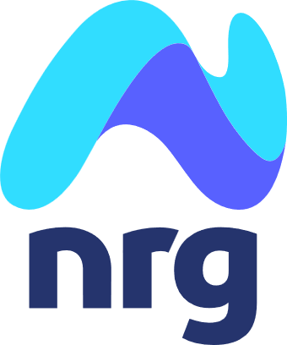















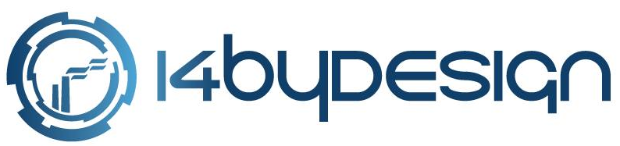






Our Clients

Slide 11

Team
Our people is our strength!
• 25 AI Experts
• 15 full-stack software developers
• 5 UI/UX designers
• 5 data scientists
• 5 mobile application engineers
• 8 web developers
• 3 AR/VR specialists
• 5 project managers
Our team is comprised of 70 highly skilled and motivated technology professionals, along with seasoned managers, all supported by an experienced C-suite and Board of Directors.

